Slide 1

THE MYSTERY
OF THE
IMMORTALITY

Slide 2
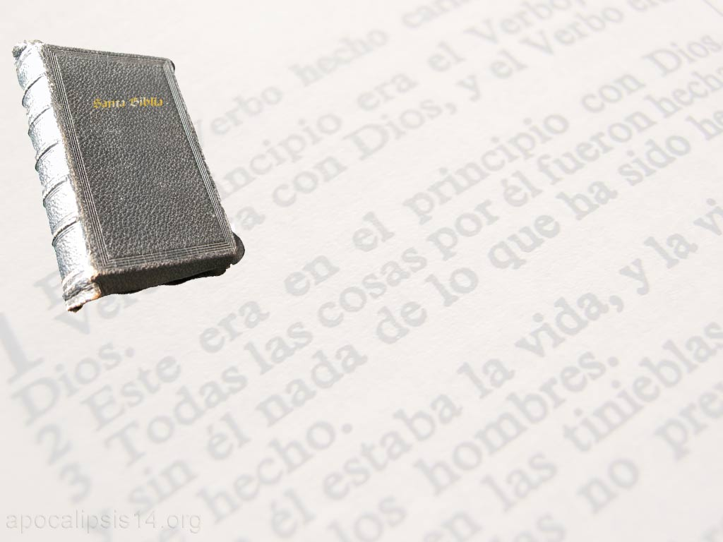
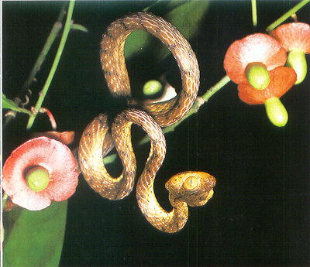
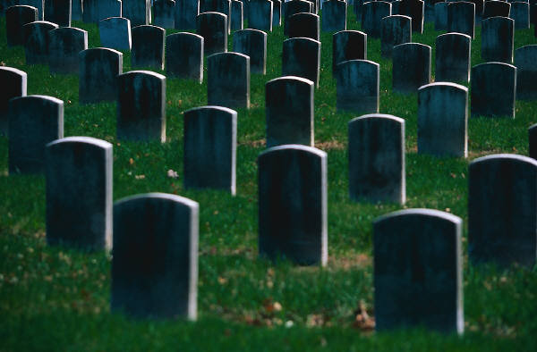
Satan's Lie:
"You Shall Surely Not Die"
Génesis, 3: 4
The truth:
"Dust you are and to the
dust you shall return"
Génesis, 3: 19

Slide 3
Adam lost immortality:
“Man is like one of us... Now therefore, let him not stretch out his hand, and take also of the tree of life, and eat, and live forever... So he cast the man out, and set cherubim to the east of the garden of Eden, and a flaming sword that was turned on every side, to guard the way of the tree of life”
Genesis 3:22-24
And after him, all men:
“Therefore, as sin entered into the world through one man, and death through sin, so death passed on to all men, because all have sinned."Romans, 5: 12

Slide 4
Can we become immortal?
Jesus Brought Immortality
“But it has now been manifested by the appearing of our Savior Jesus Christ, who took away death and brought to light life and immortality by the gospel."2 Timothy 1:10
and gives it to those who believe:
“He who believes in the Son has eternal life."John, 3: 36

Slide 5
Satan's Lie TODAY:
The Soul Is Immortal
The Truth TODAY:
"The soul that sinneth,
it shall die."
Ezekiel, 18: 20

Slide 6
Consequences of the Natural Immortality of the Human Soul
POSSIBILITIES OF THE SOUL AT THE DEATH OF THE BODY
Going to Heaven: Hope that comforts the believer.
Going to Hell: Eternal Suffering of the Sinner.
Go to "limbo": Disembodied spirits wandering aimlessly and communicating with the living.
Reincarnation: New life with no conscious memory of the previous one.

Slide 7
Consequences of the Natural Immortality of the Human Soul
IF WE GO TO HEAVEN
Would we be happy to see the sufferings and mistakes of our beloved family and friends?
Wouldn't we try to help them to save themselves?
Notes:
La parábola del rico y Lázaro ilustra la imposibilidad de comunicación y vivos y muertos y su razonamiento lógico

Slide 8
Consequences of the Natural Immortality of the Human Soul
IF HELL EXISTS
God and the saints are sadists who enjoy the eternal suffering of sinners.
Eternal punishment is disproportionate to the faults that can be committed in a short life

Slide 9
Consequences of the Natural Immortality of the Human Soul
IF WE BECOME
DISEMBODIED SPIRITS
If we all have the same destiny, what does it matter what we do in this life?
Let us eat and drink, for tomorrow we shall die.

Slide 10

Almost all Christian churches have taught one of the following errors (with some variations):
There is a hell where sinners suffer eternally.
God is so good that He saves all men. Therefore, man ascends directly to heaven at death.
Today, Christian churches tend to favor the second error, including the Catholic Church.

Slide 11

In the attempt to find biblical support for universal salvation, the most blatant misrepresentation has been reached. An example of this is the use of the following passage:
"And the soul of king David
longed to go forth unto Absalom: for he was comforted
concerning Amnon, seeing he was dead."
2 Samuel, 13:39
Notes:
Para muestra de cómo los que creen en la salvación universal tuercen el sentido de las Escrituras para sostener sus dogmas deletéreos para las almas, basta citar sus propias declaraciones. En los funerales de un joven irreligioso, muerto instantáneamente en una desgracia, un ministro universalista escogió por texto de su discurso las siguientes palabras que se refieren a David: "Ya estaba consolado acerca de Amnón que era muerto." (2 Samuel 13: 39.)
"A menudo me preguntan -dijo el orador- cuál será la suerte de los que mueren en el pecado, tal vez en estado de embriaguez, o que mueren sin haber lavado sus vestiduras de las manchas ensangrentadas del crimen, o como este joven, sin haber hecho profesión religiosa ni tenido experiencia alguna en asuntos de religión. Nos contentamos con citar las Sagradas Escrituras; la contestación que nos dan al respecto ha de resolver tan tremendo problema. Amnón era pecador en extremo; era impenitente, se embriagó y fue muerto en ese estado. David era profeta de Dios; debía saber si Amnón se encontraba bien o mal en el otro mundo. ¿Cuáles fueron las expresiones de su corazón? -'El rey David deseó ver a Absalom: porque estaba consolado acerca de Amnón que era muerto.'
"¿Y qué debemos deducir de estas palabras? ¿No es acaso que los sufrimientos sin fin no formaban parte de su creencia religiosa? -Así lo entendemos nosotros; y aquí encontramos un argumento triunfante en apoyo de la hipótesis más agradable, más luminosa y más benévola de la pureza y de la paz finales y universales. Se había consolado de la muerte de su hijo. ¿Y por qué?- Porque podía con su ojo de profeta echar una mirada hacia el glorioso estado, ver a su hijo muy alejado de todas las tentaciones, libertado y purificado de la esclavitud y corrupciones del pecado, y, después de haber sido suficientemente santificado e iluminado, admitido a la asamblea de espíritus superiores y dichosos. Su solo consuelo consistía en que su hijo amado al ser recogido del presente estado de pecado y padecimiento, había ido adonde el soplo sublime del Espíritu Santo sería derramado sobre su alma obscurecida; adonde su espíritu se desarrollaría con la sabiduría del cielo y con los dulces transportes del amor eterno, a fin de ser así preparado para gozar con una naturaleza santificada del descanso y de las glorias de la herencia eterna.
"Con esto queremos dar a entender que creemos que la salvación del cielo no depende en nada de lo que podamos hacer en esta vida, ni de un cambio actual de corazón, ni de una creencia actual ni de una profesión de fe religiosa." CS pgs. 593-594

Slide 12

Biblical Teaching on Man's Universal Salvation
NOT EVERYONE WILL GET INTO HEAVEN
"Do you not know that the unrighteous will not inherit the kingdom of God? Do not be mistaken; neither fornicators, nor idolaters, nor adulterers, nor effeminate, nor those who lie with men, nor thieves, nor covetous, nor drunkards, nor slanderers, nor swindlers, shall inherit the kingdom of God.“ 1 Corinthians 6:9-10
"For you know this, that no fornicator, or unclean, or covetous, who is an idolater, has an inheritance in the kingdom of Christ and of God.“ Ephesians 5:5
"Pursue peace with all, and holiness, without which no man shall see the Lord.“ Hebrews 12:14

Slide 13
Biblical Teaching on Man's Universal Salvation
THE SINNER WILL BE PUNISHED
"Woe to the wicked! Evil will go with him, for according to the works of his hands it will be repaid to him.“ Isaiah, 3:11
"The Lord keepeth all that love him, but he will destroy all the wicked"
Psalm 145:20
"But the transgressors shall all be destroyed together; the posterity of the wicked shall be extinguished.“ Psalm 37:38

Slide 14
Like the waters of the flood, the flames of the great day will proclaim God's verdict that the wicked are incurable. They have no disposition to submit to divine authority. They have exercised their will in rebellion; And when life is over it will be too late to turn the current of your thoughts in the opposite direction, too late to turn from transgression to obedience, from hatred to love. Ellen White. The Great Controversy, pg. 598
When will the wicked receive?
their punishment?

Slide 15

All will be resurrected, both righteous and unjust
"There Must Be A Resurrection Of The Dead, Both The Righteous And The Unjust“ Acts 24:15
"For as in Adam all die, so in Christ shall all be made alive."1 Corinthians 15:22
"Do not marvel at this; for the hour will come when all who are in the graves will hear his voice; and those who have done good will come forth to the resurrection of life; but those who have done evil have risen from condemnation.“ John 5:28-29

Slide 16
If they are all resurrected,
¿What's the matter
with the
Resurrected
that they can't
enter heaven?

Slide 17

The Resurrection
of the wicked
is followed by
The 2nd Death
"Blessed and holy is he that hath a part in the first resurrection; the second death has no power over them.“ Revelation, 20:6

Slide 18
The Second Death Does Not
Imply Eternal Suffering
"For henceforth there will be no wicked man; you will observe his place, and he will not be there.“ Psalm 37:10
"You rebuked the nations, you destroyed the wicked. You blotted out their name eternally and forever. The enemies have perished; they have been left desolate forever; and the cities which thou hast brought down, their memory perished with them.“ Psalm 9:5-6
"They will be as if they had not been“ Obadiah, 16

Slide 19
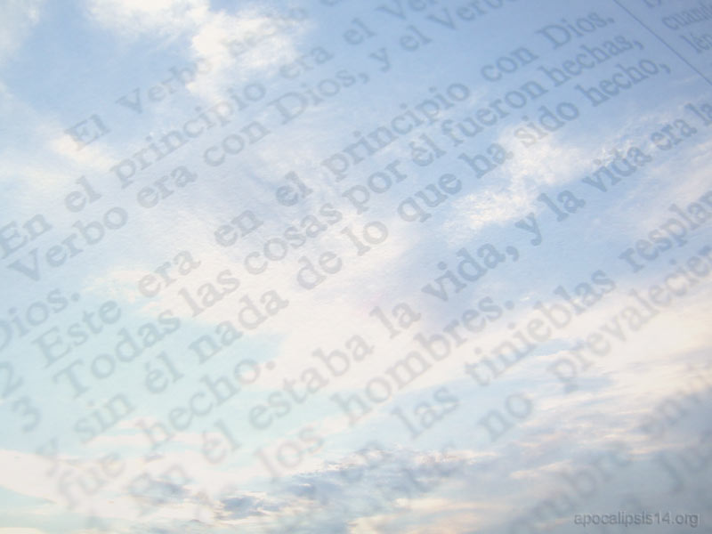
ALL WHO ARE LEFT IN HEAVEN WILL GIVE GLORY TO GOD
"And to all created things that are in heaven, and on the earth, and under the earth, and in the sea, and all things that are in them, I heard it said, To him who sits on the throne, and to the Lamb, be praise, and honor, and glory, and power, forever and ever.“ Revelation, 5:13

Slide 20

WHAT HAPPENS BETWEEN
DEATH AND
RESURRECTION?

Slide 21
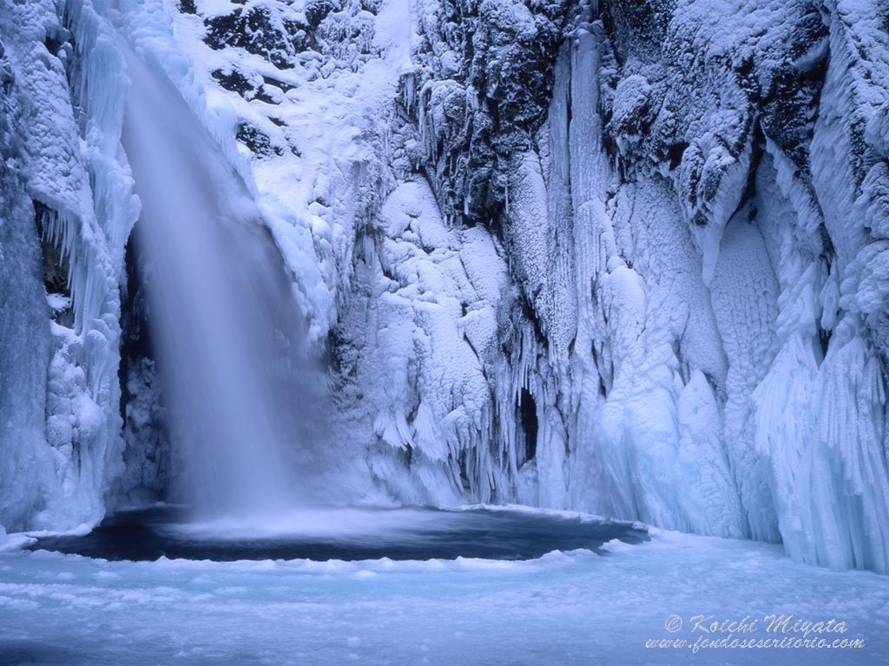
What does the Bible say about death?
"For his breath proceedeth out, and return to the earth; On that very day his thoughts perish.“ Psalm 146:4
"For they that live know that they shall die; but the dead know nothing... Their love and hatred and envy are gone; and they will never again have a share in all that is done under the sun.“ Ecclesiastes 9:5-6
"Whatever comes into your power to do, do it according to your strength; for in Sheol, whither thou goest, there is no work, no work, no knowledge, no wisdom.“ Ecclesiastes 9:10

Slide 22
No one praises God when he has died
"For Sheol will not exalt you, nor death praise you; nor shall they that go down to the grave wait for thy truth.” Isaiah, 38:18
"For in death there is no remembrance of thee; in Sheol, who will praise you?” Psalm 6:5
"The dead shall not praise God, nor all who descend into silence“ Psalm 115:17

Slide 23
THE CASE OF KING DAVID
"Men and brethren, you may freely be told of the patriarch David, who died and was buried... For David did not ascend into heaven.“ Acts 2:29, 34

Slide 24
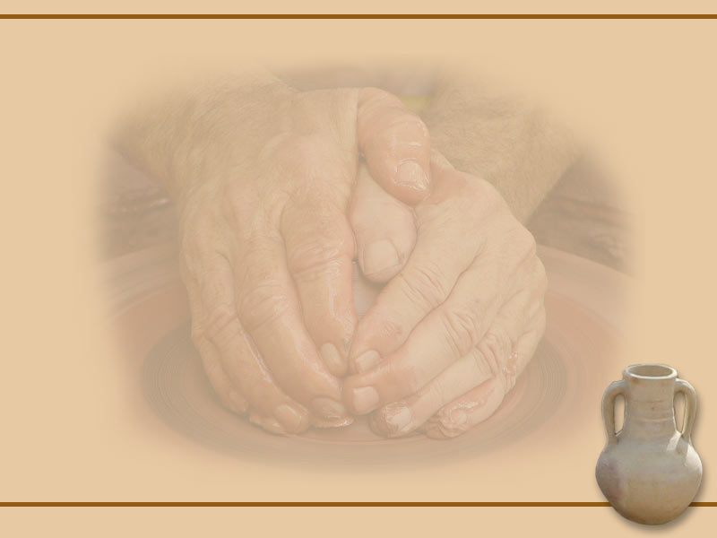
The doctrine of the immortality of the soul nullifies the resurrection
"I frankly confess that I am not convinced that they already enjoy the fullness of glory in which God and the elect angels find themselves. Nor is it an article of my faith; for if it were so, then I cannot but see that the preaching of the resurrection of the flesh would be in vain.“
William Tyndale, in the foreword to his translation of the New Testament

Slide 25
The doctrine of the immortality of the soul nullifies the 2nd coming of Christ
Those who believe in immortality claim:
"For all practical purposes of comfort, the doctrine of the blessed immortality of the righteous supersedes for us any doubtful doctrine of the Lord's second coming. When we die is when the Lord comes to get us. That is what we have to wait for and for which we must be cautious. The dead have already entered into glory. They do not wait for the sound of the trumpet to stand in judgment and enter into beatitude."
The Bible states:
"For the Lord himself shall come down from heaven with a shout, with the voice of the archangel, and with the trumpet of God; and the dead in Christ will rise first. Then we who are alive, who are left, will be caught up with them in the clouds to meet the Lord in the air, and so we will be with the Lord always. Therefore encourage one another with these words."
1 Thessalonians, 4:16-18

Slide 26
Men Are Not Judged When They Die
"For He hath appointed a day in which He shall judge the world in righteousness“ Acts 17:31
"And to the angels who did not keep their dignity... he has saved them... for the judgment of the great day“ Jude, 6
"And I saw the dead, great and small, standing before God; and the books were opened, and another book was opened, which is the book of life; and the dead were judged by the things that were written in the books, according to their works.“ Revelation, 20:12

Slide 27

History of the Doctrine of Immortality in Christianity
Rome took this doctrine from paganism.
Luther classed it alongside "the monstrous fables that are part of the Roman dunghill"
However, both Catholicism and Protestantism today embrace this doctrine.

Slide 28



WHEN MAN DIES
The spirit (breath of life) returns to God, who gave it
Ecclesiastes, 12:6; Genesis 2:7
The body returns to dust
Genesis 3:19
Thoughts and activity end
Eclesiastés, 9: 10

Slide 29
The first conscious act,
after death,
It will be the resurrection
RESURRECTION OF LIFE
At the Second Coming
RESURRECTION FROM DEATH
After the millennium
They will receive immortality and
live with Christ forever
They will suffer the second
Death In the Lake of Fire
In this life we decide our future...
AT WHAT POINT WILL YOU BE RESURRECTED?
They will cease to exist

Slide 30
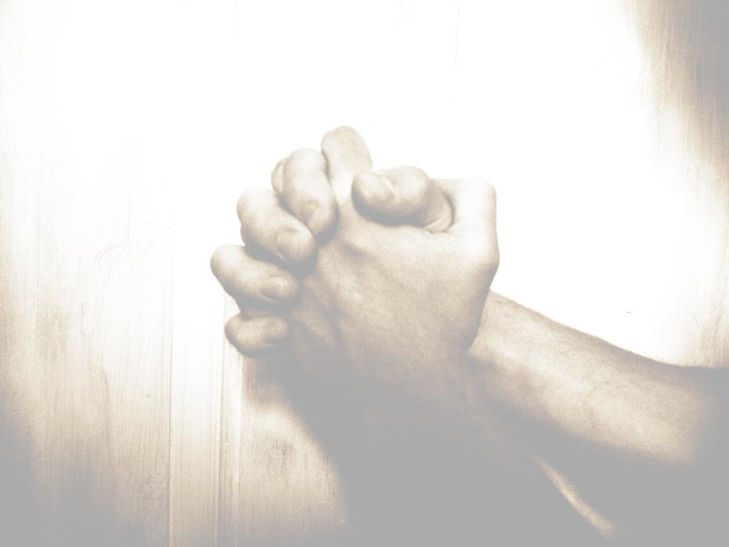
"In a moment, in the twinkling of an eye, at the last trumpet; for the trumpet shall be sounded, and the dead shall be raised incorruptible, and we shall be changed. For this corruptible must be clothed with incorruption, and this mortal must be clothed with immortality. And when this corruptible shall put on incorruption, and this mortal shall put on immortality, then shall be fulfilled the word which is written, Death is swallowed up in victory. Where, O death, is thy sting? Where, O grave, is thy victory?“
1 Corinthians, 15:52-55

Slide 31
Elaborado con la ayuda del Señor por la familia Fustero (España) info@fustero.es
http://www.fustero.es

